Slide 1

Lock Picking
Cyber Security And Intel Club

Slide 2
Introductions CIC will provide support for student learning by creating a community for those interested in cybersecurity and information security. Activities may range from student gatherings to industry speakers and professional conferences
President : Austin Turecek
Vice President: Samuel Munhal
Treasurer: Tyler Breuler
Secretary: Daniela Catrambone
Advisor: Doug White

Slide 3
LEGAL DISCLAIMER
The Cyber Security and Intel Club, and its E-Board, do not hold any responsibility for any actions or consequences taken during or after this presentation. The information expressed in this presentation is purely for educational purposes. It is not to be used for any illegal or malicious actions. Any illegal or malicious actions are the sole responsibility of the perpetrator. The RWU Cyber Security and Intel Club holds no liability in these situations. However, any cool stories that occur due to this presentation should begin with “This one time at the Cyber Security and Intel Club, which you can join by signing up on Hawk Link, I learned….” By continuing to participate in this presentation and the demonstrations that follow, you agree to these terms and conditions.

Slide 4
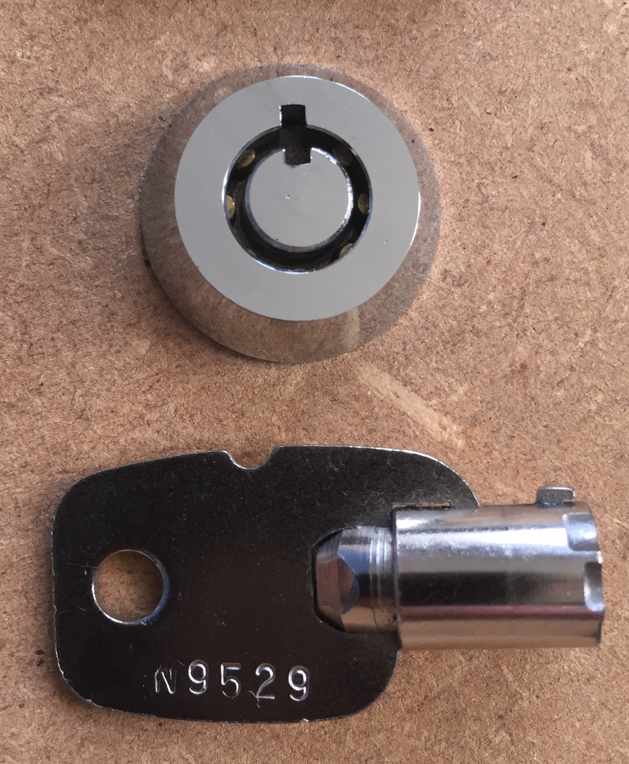
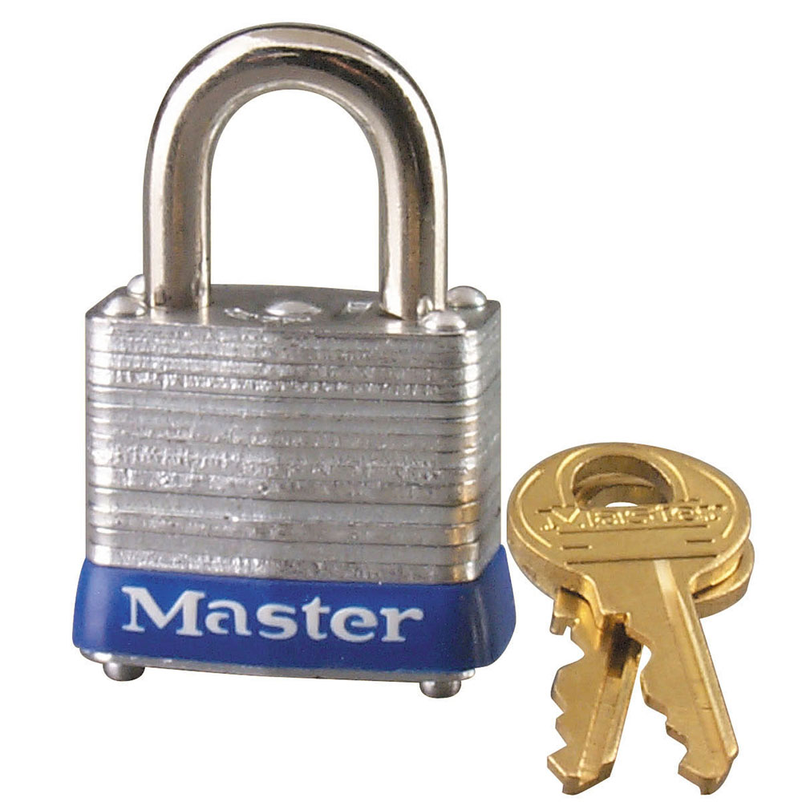
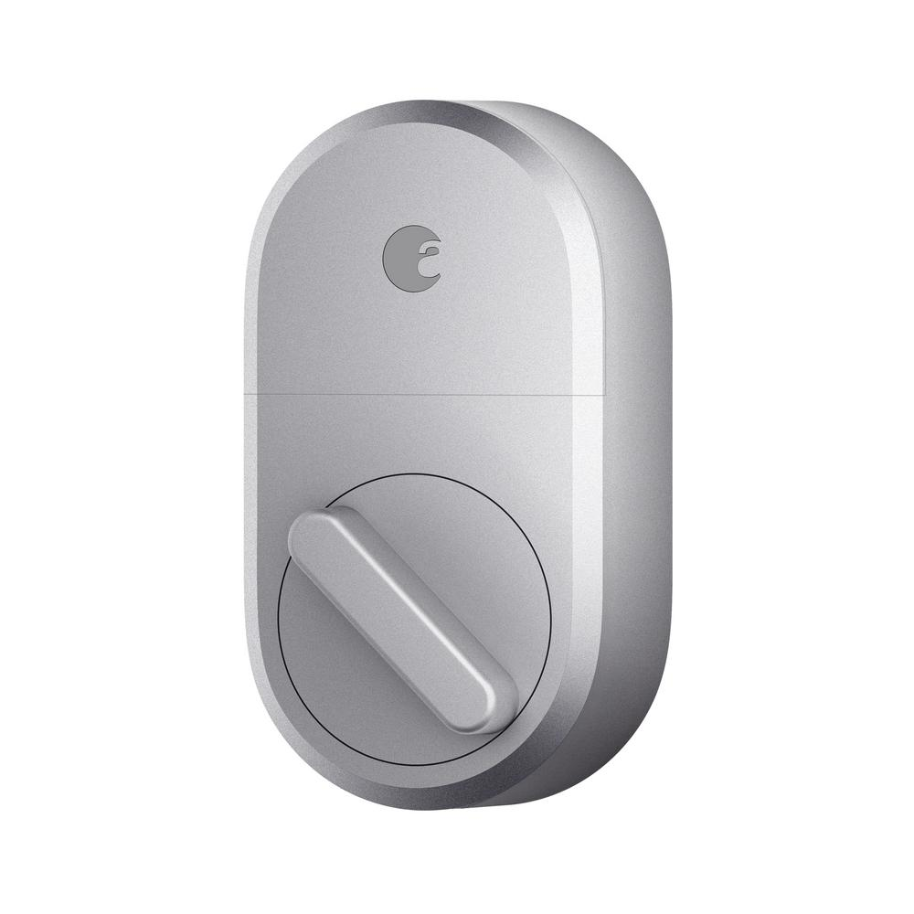
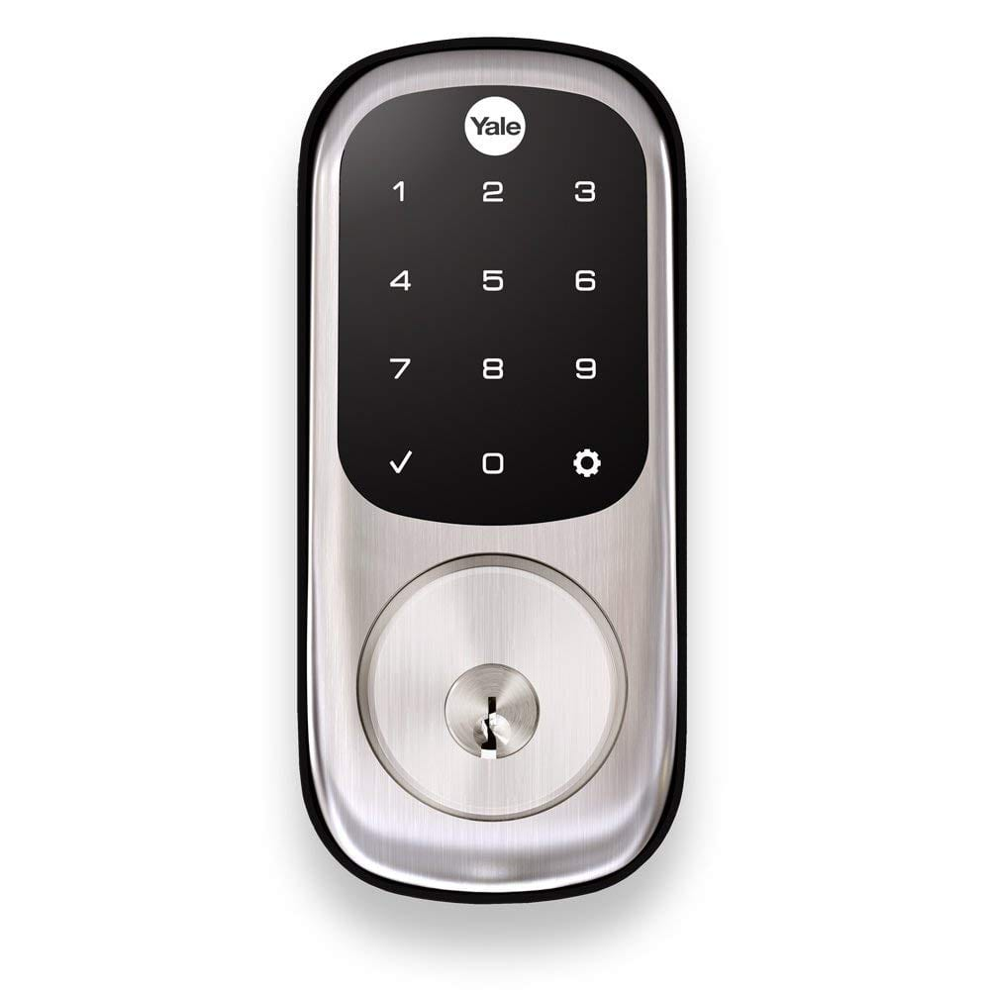
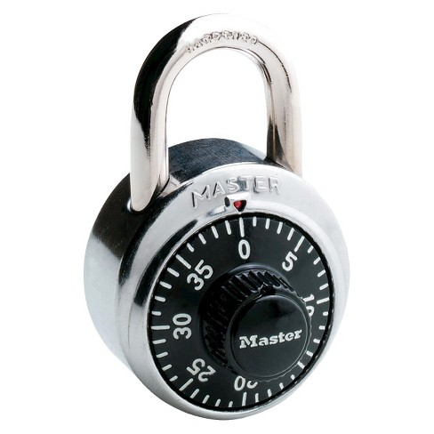
Lock Types

Slide 5

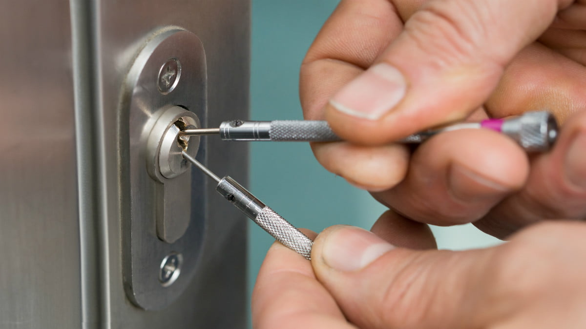

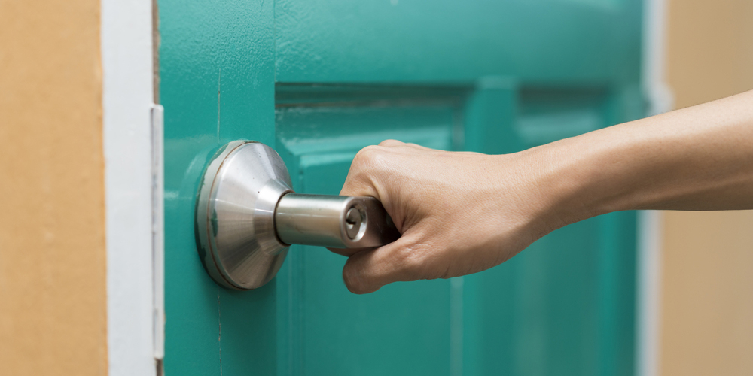
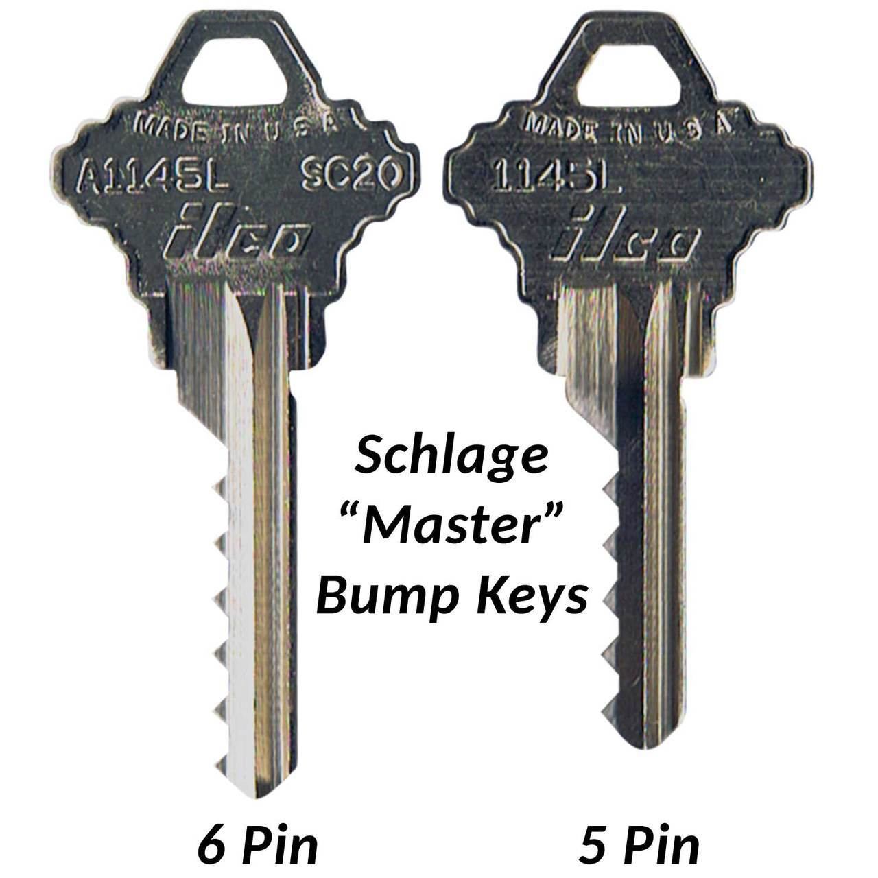

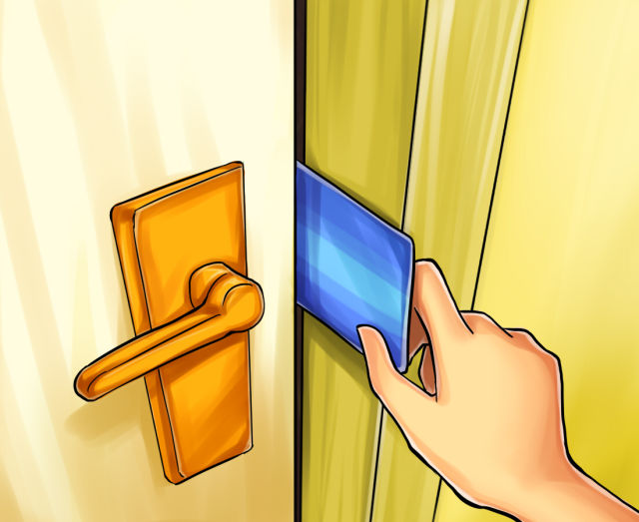
Lock Bypass Methods
Least Noticeable
Most Noticeable

Slide 6
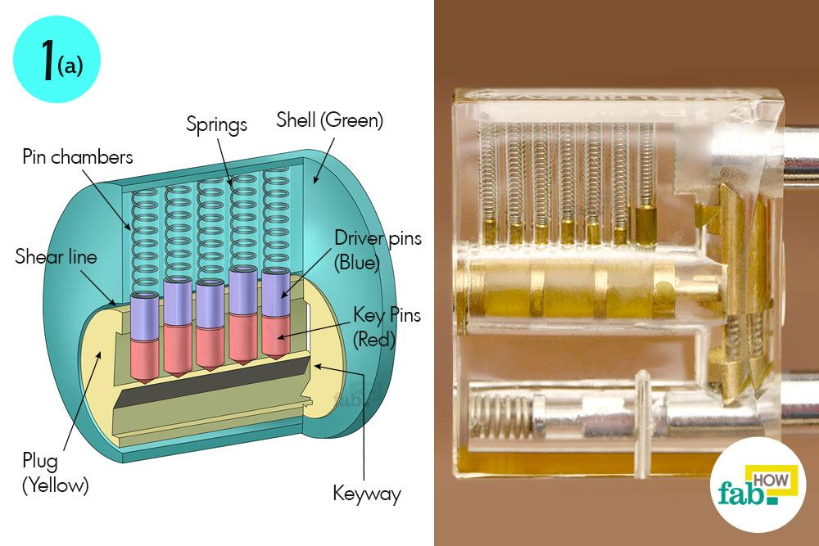
Lock Internals

Slide 7
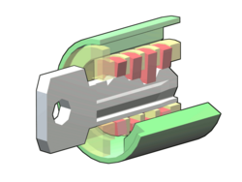
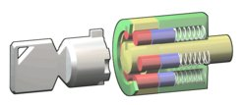
Other Lock Guts

Slide 8
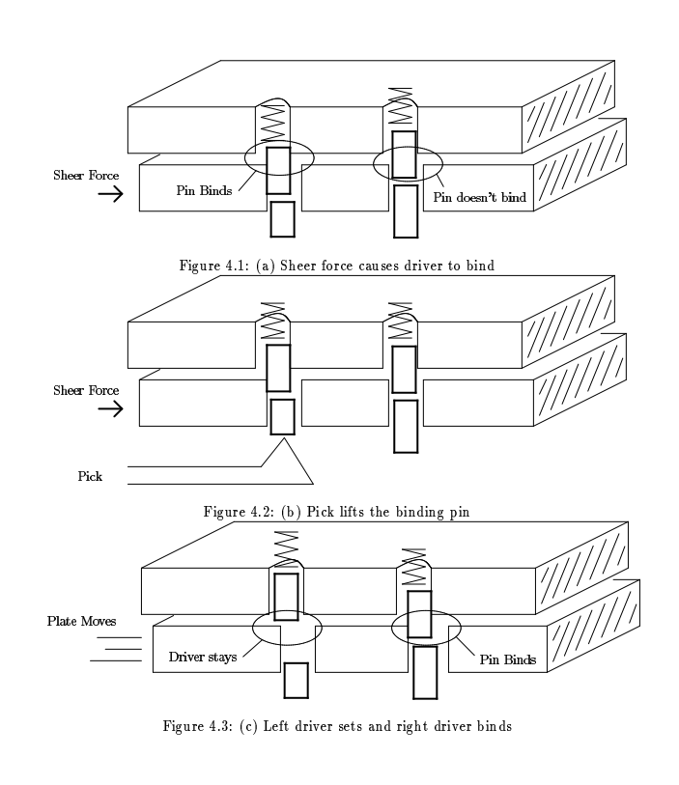
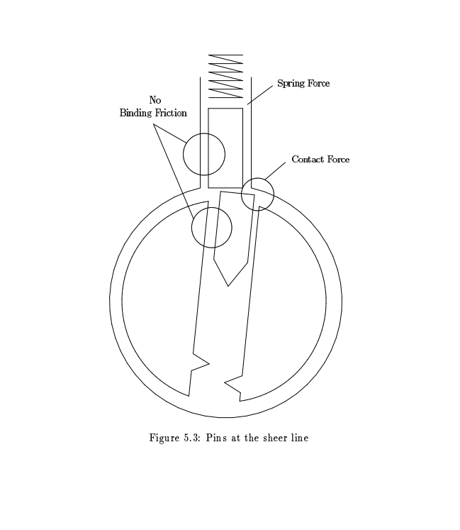
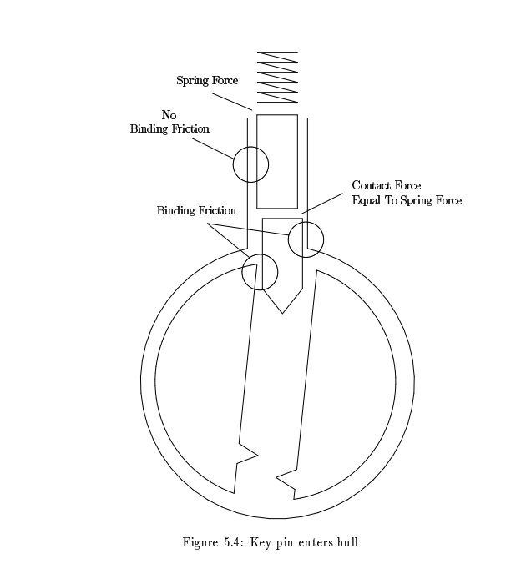
The Science of Picking

Slide 9
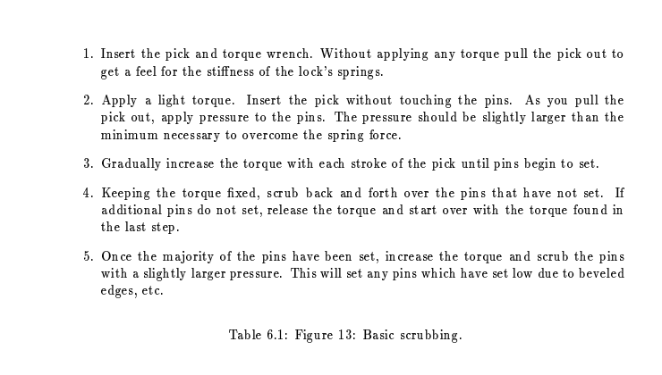
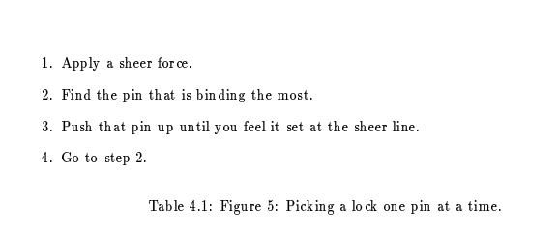
The Actual Thing You Came Here For

Slide 10
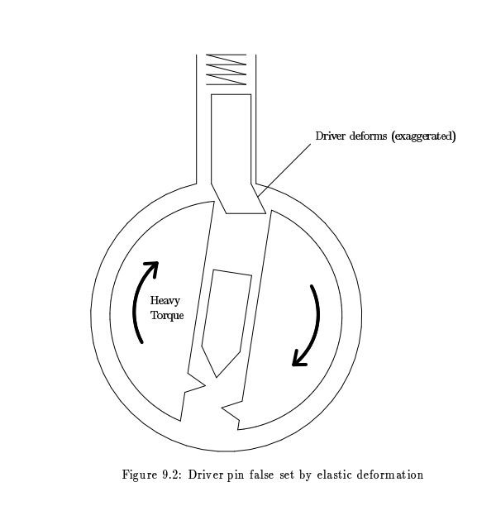
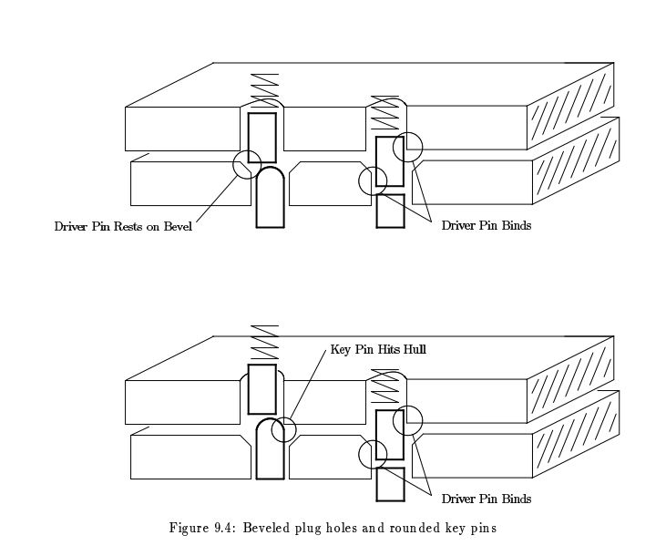
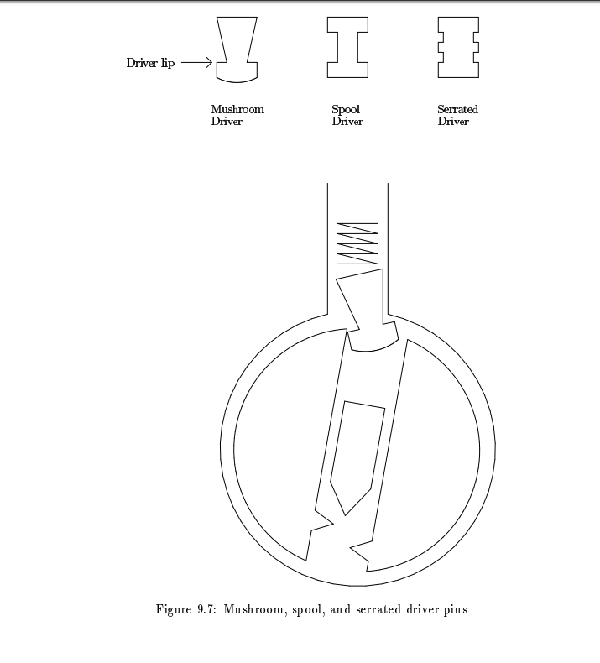
Challenges You Gotta Deal With

Slide 11
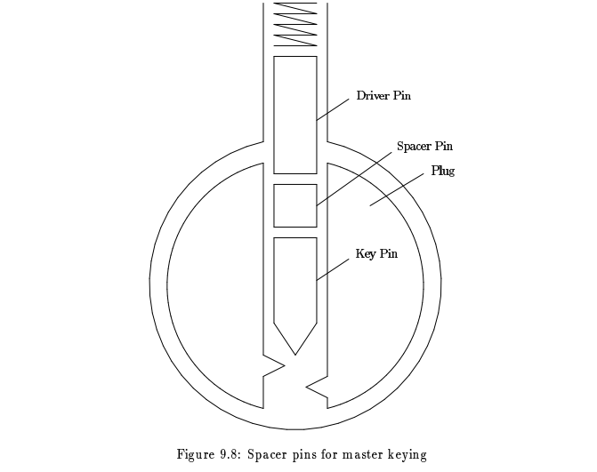
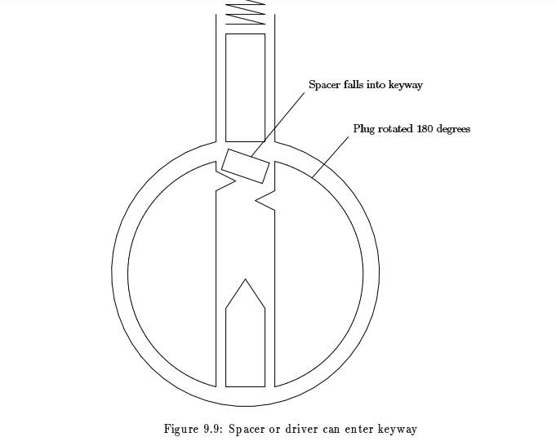
More Challenges You Gotta Deal With (Sorry)

Slide 12

Questions?

Slide 13

Thank You

Slide 14
Resources
https://www.lysator.liu.se/mit-guide/MITLockGuide.pdf
http://www.lockpickguide.com/

Slide 15

LET’S PICK SOME LOCKS

